Slide 1


Welcome To English Class

Slide 2

Nizam Uddin Jewel
Assistant Teacher
Baher Cor govt.primary school, Raypura, Narsingdi.
Email:nizamuddinjewel
@gmail.com

Slide 3

Class:Five
Sub:English
Lesson:24,
Unit:9^{th -}last lines
Page:85

Slide 4
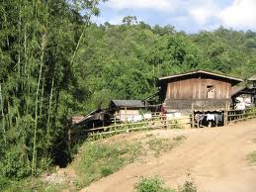
Learning outcomes:
Students will be able to:
read the poem with correct pronunciation and stress.
2)Know about City Streets and Country Roads.

Slide 5

Safe learning environment: by watching video clip

Slide 6
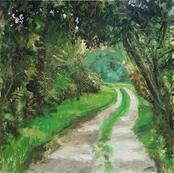
City Streets and
Country Roads

Slide 7

Teachers loud reading

Slide 8
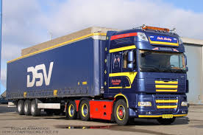
In the city one sees
Big trucks rattle by,

Slide 9
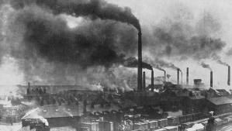
And the smoke of the factories
That blot out the sky,

Slide 10
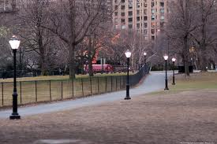
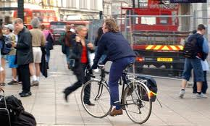
And all down the pavements
Still lamp posts one sees-

Slide 11
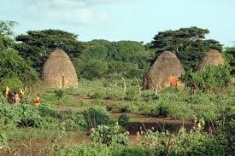
But the country has hedge rows

Slide 12
Students loud reading

Slide 13
New words: Lamp post Hedge

Slide 14
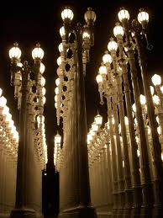
Word meaning
Lamp post: light post
Hedge : small tree

Slide 15
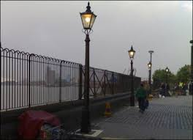
Make sentence
Lamp post: City has
lamp post.
Hedge: The country has
hedge rows

Slide 16
Silent reading

Slide 17
Rearrange lines
That blot out the sky,
And the smoke of the factories
And all down the pavements
Big trucks rattle by,
Still lamp posts one sees-
In the city one sees,

Slide 18
Group work
Group A
Read the poem 9th- 12th lines
Group B
Read the poem
^{13 th}-last line

Slide 19
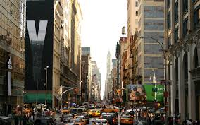
Home work.
Write 5 sentence about your City Streets

Slide 20
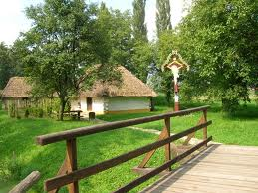
Thanks my dear students, bye, see you tomorrow

